Slide 1
CSX4109 / ITX4109
ANDROID APPLICATION DEVELOPMENT

Slide 2
DEVELOPMENT TOOL

Slide 3
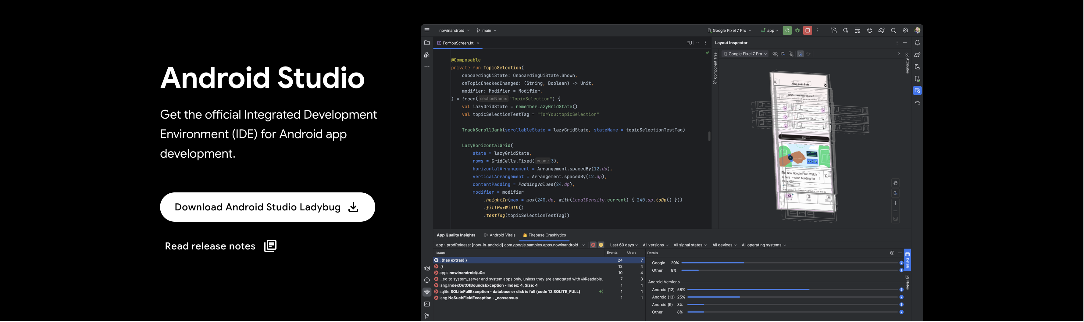
ANDROID STUDIO
https://developer.android.com/studio

Slide 4
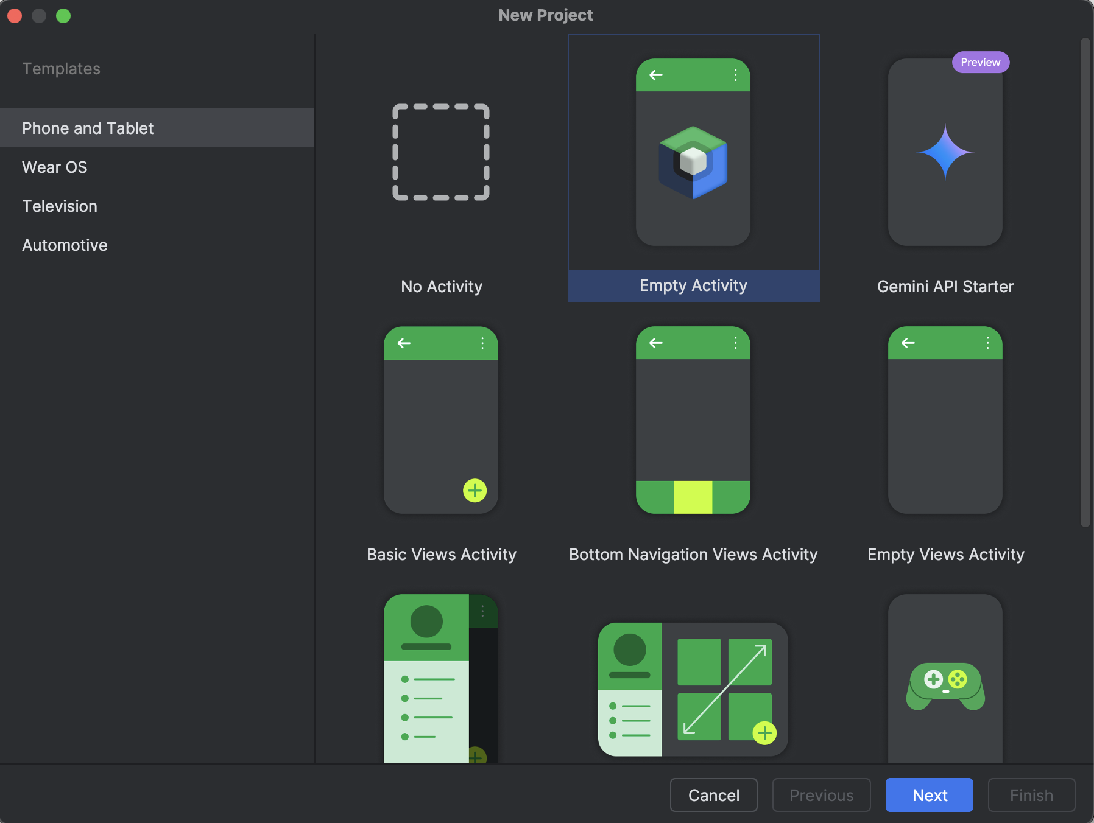

Slide 5
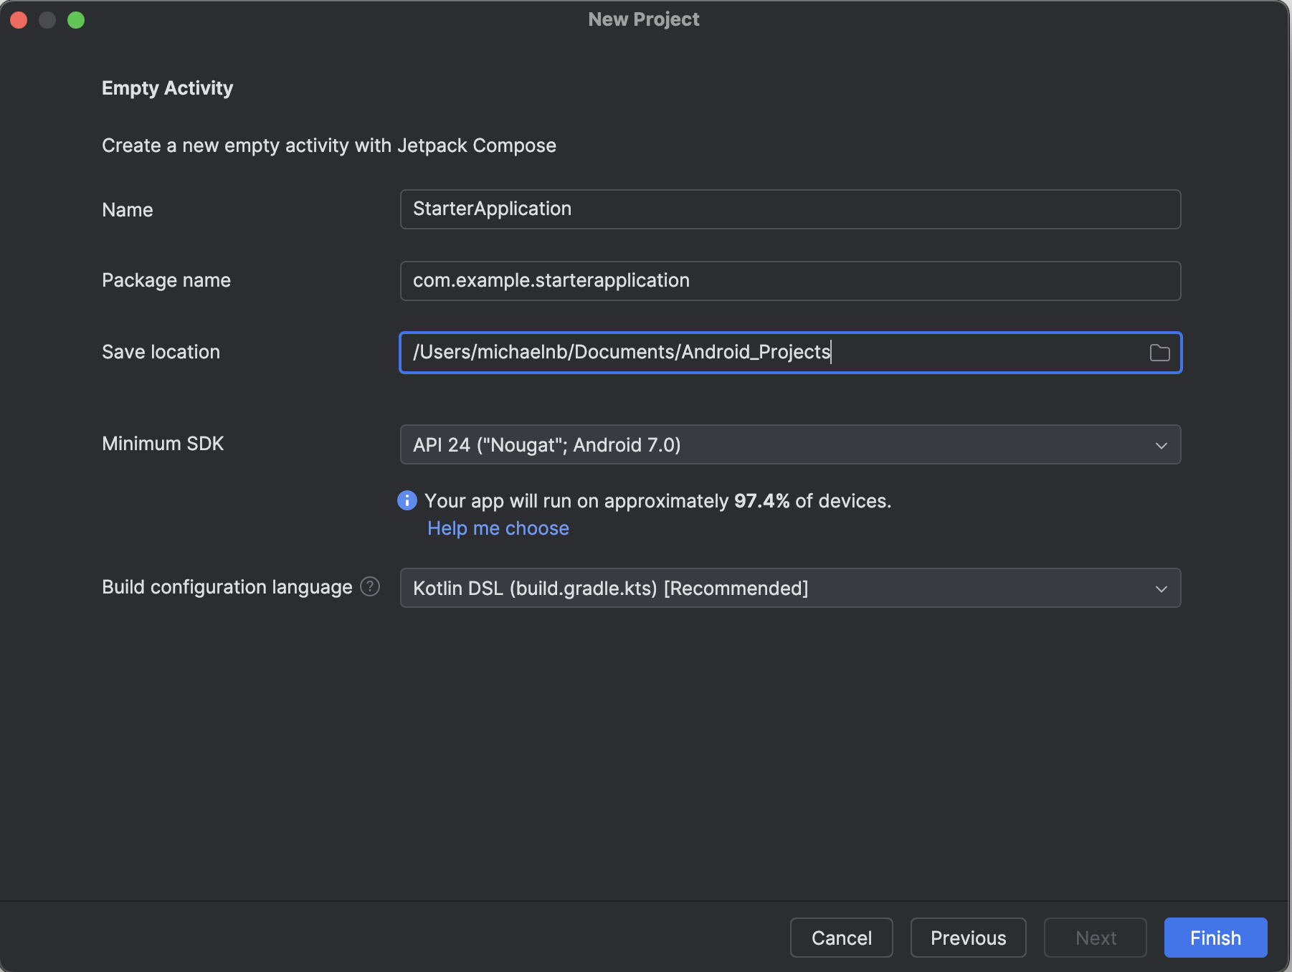

Slide 7
WAIT FOR A FEW MINS…

Slide 8
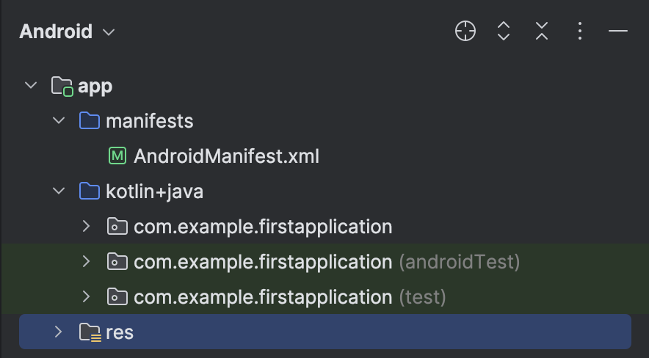
APP MODULE

Slide 9
MANIFEST
App Component
Permission
Hardware and Software Feature

Slide 10
GRADLE
Build Variant
Resource Shrinking
Dependency Management

Slide 11
BUILD VARIANT
Free and Paid Version
Staging, Beta, Production, etc.
Multiple API Version Support

Slide 12
RESOURCE SHRINKING
Code and Resource Shrinking
Optimization
Obfuscation

Slide 13
DEPENDENCY MANAGEMENT
Library Integration
Plugin Integration
Dependency Versioning Management

Slide 14
LET’S CREATE YOUR 1ST APP!

Slide 15
ACTIVITY
An Application Screen
Application Entry Point
The Window for The App Draws UIs

Slide 16
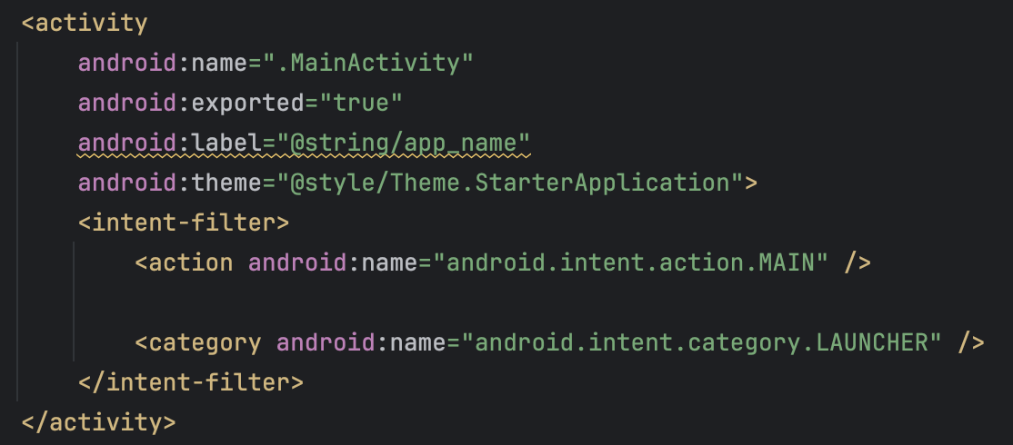
ACTIVITY DECLARATION

Slide 17
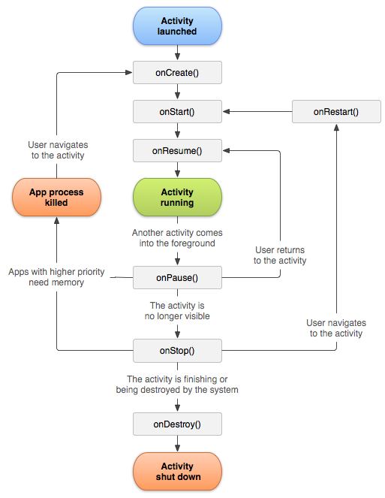
ACTIVITY LIFECYCLE
Ref: https://developer.android.com/guide/components/activities/activity-lifecycle

Slide 18
OnCreate
Implementation Required
Application Startup Logic
Called Only Once

Slide 19
OnStart
Visible to User
Interaction Preparation
UI Maintenance Initialization

Slide 20
OnResume
Foreground and Interactive
Stay Until Something Happens (E.g. Phone Call, User Navigation, Turning Screen Off, etc.)
OnPause Called when Interruptive Occurs

Slide 21
OnPause
Called when About to leave an activity
Visible but Not Focused
Opening a New Semi-Transparent Activity (E.g. Opening a dialog)
No Heavy Operation (E.g. Network Call, Database Transaction Execution, Saving Data, etc.)

Slide 22
OnStop
Not Visible
Activity Object is Kept in Memory
Suitable for Intensive Operations

Slide 23
OnDestroy
Activity Dismissed
Configuration Changed (E.g. Device Rotation)
All Resource Released

Slide 24
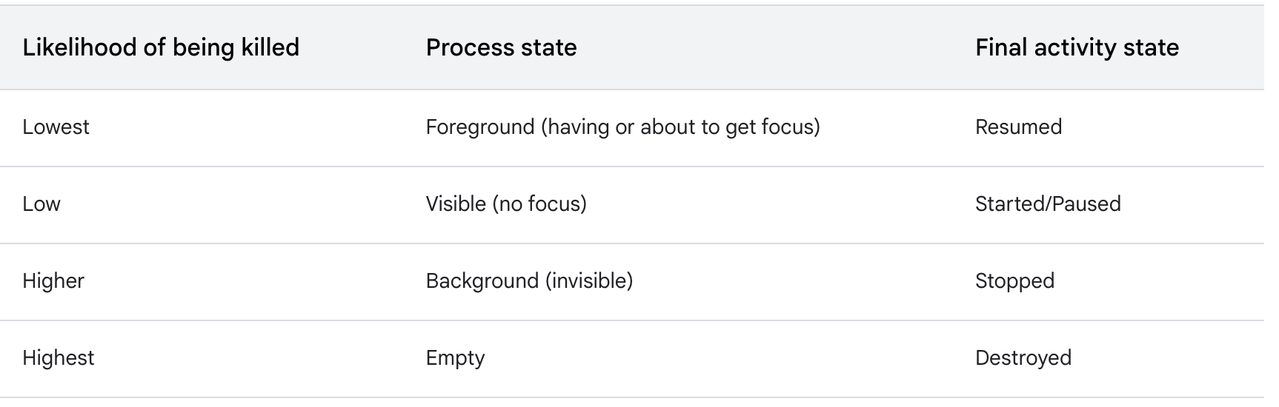
ACTIVITY STATE & MEMORY EJECTION
https://developer.android.com/guide/components/activities/activity-lifecycle#asem

Slide 25
EXCERCISE 1
Adjust the application to have a text field for entering the faculty the student is in and manage the state to support the device orientation changing. The name the user enters must be preserved even if the device is rotated to another orientation

Slide 26
EXCERCISE 2
Adjust the application to have a button, labelled “Count”. When the user taps the button, it increases the number of the times the button is tapped in a text above the button. The times of the button being tapped must be preserved even if the device is rotated to another orientation

Slide 27
LET’S CREATE ANOTHER ACTIVITY!

Slide 28
CAN YOU GUESS?
If the activity A tries to open the activity B, how are the lifecycles of these two activities?

Slide 29
EXCERCISE 3
Add the logging for each state of the activity lifecycle in the second activity

Slide 30
THANK YOU

